Slide 1

Modern Application Deployment on Cloud
Serverless, Security, and CI/CD with GenAI Agents
Mayur Madnani

Slide 2



Today's Roadmap
The "Why"
The "What"
The "How"
Understanding the strategic value of moving to cloud and serverless architecture for modern AI deployments.
Deploying a production-ready GenAI Agent (Gemma) on Cloud Run with real-world configurations.
Implementing Zero Trust security principles and automating deployments with robust CI/CD pipelines.
We aren't just deploying a "Hello World" application. We're building a production-ready path for an AI application—from strategy through manual deployment to complete automation.

Slide 3
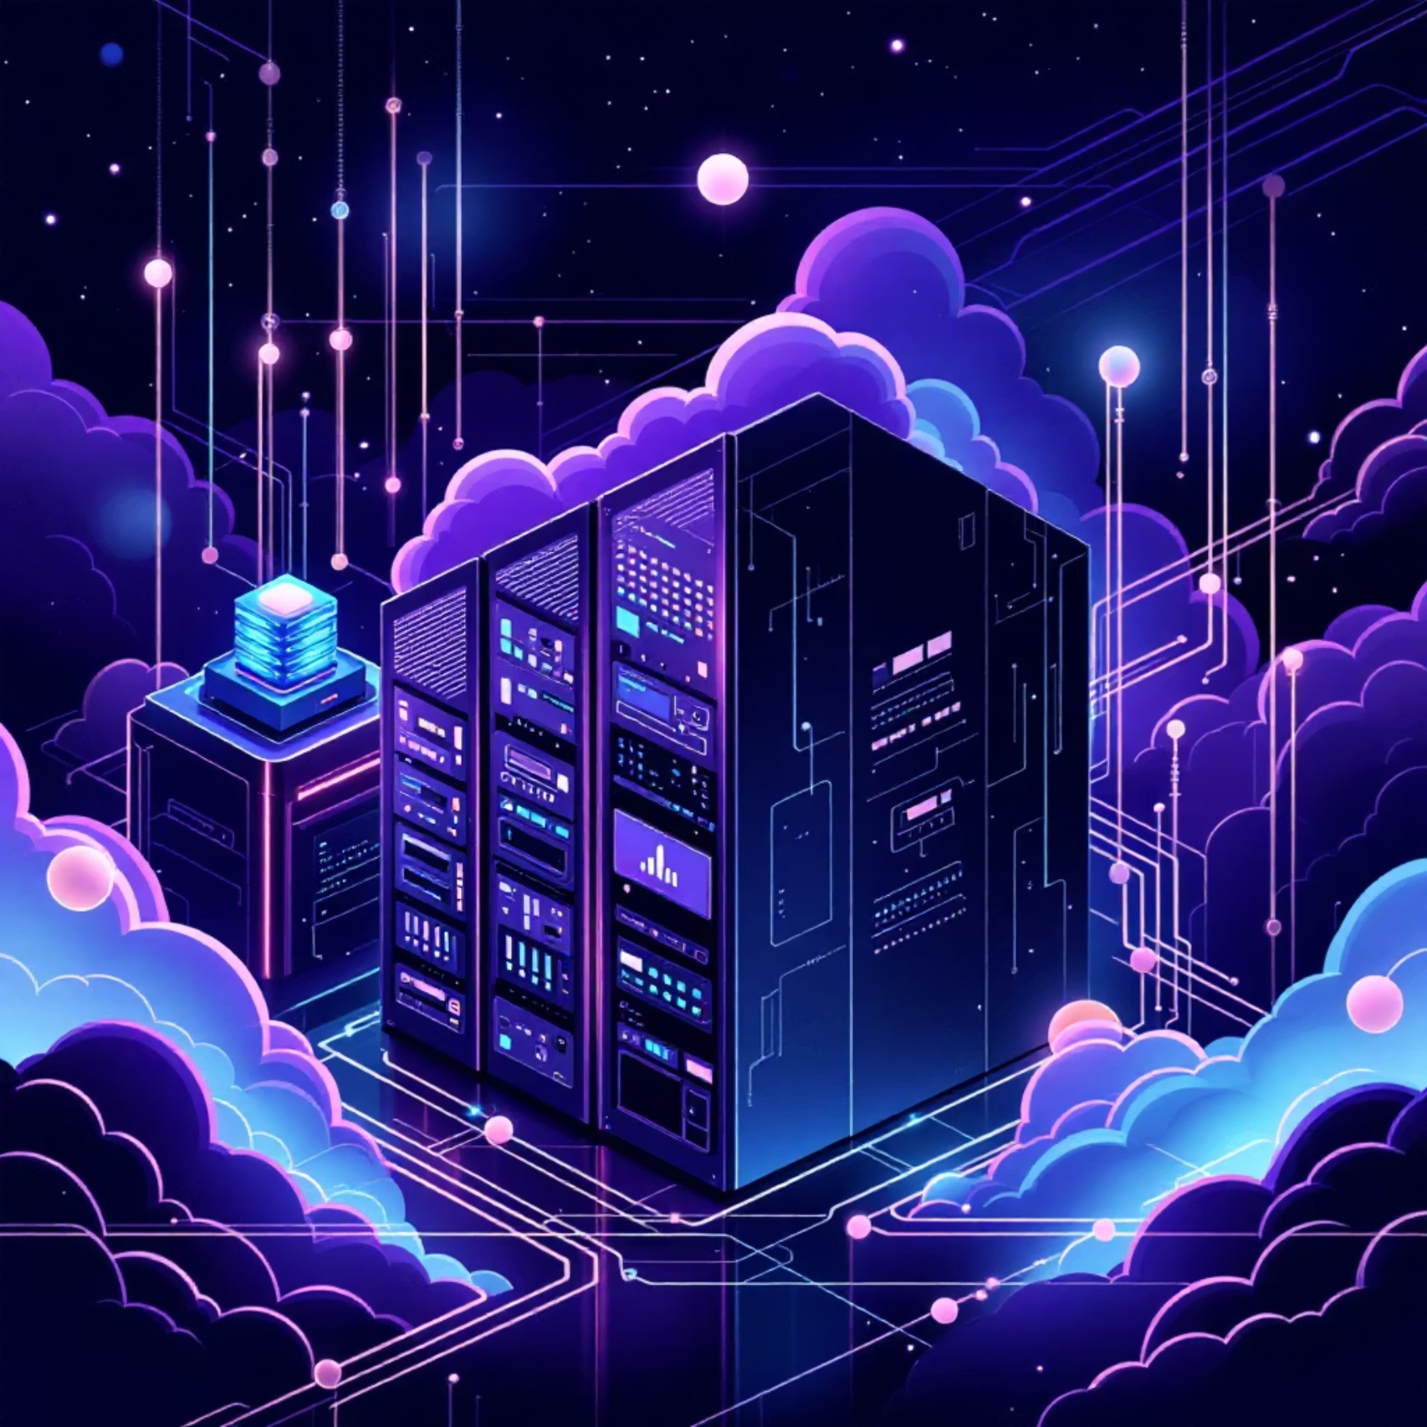
The Shift to Cloud Computing
Why Move to the Cloud?
Scalability: Handle 1 user or 1 million users automatically without infrastructure changes
Agility: Provision infrastructure in seconds, not weeks—accelerate development cycles
Global Reach: Deploy code closer to your users across regions and zones worldwide
Focus: Spend time on code, not cables—let experts manage hardware

Slide 4

The Economics: CapEx vs. OpEx
CapEx (Capital Expenditure)
High upfront cost. Buying servers hoping you'll need them.
Large initial investment
Fixed capacity regardless of usage
Paying for capacity you might use
Depreciation over time
OpEx (Operational Expenditure)
Pay-as-you-go. Flexible spending that scales with demand.
No upfront hardware costs
Dynamic resource allocation
Paying only for what you actually use
Predictable monthly billing

Slide 5




Choosing Your Compute Model
Serverless
"Run the code." Zero infrastructure management.
CaaS (Kubernetes)
"Orchestrate the containers."
High portability, complex management.
IaaS (VMs)
"Rent the hardware."
Maximum control, maximum maintenance.
Each layer up the pyramid abstracts away more infrastructure complexity

Slide 6





Benefits of Serverless for AI
No Ops
Eliminate server patching, OS updates, and infrastructure maintenance entirely.
Scale to Zero
If no requests arrive, 0 instances run = $0 cost. Pay only when serving traffic.
Fast Autoscaling
Scales up instantly when traffic spikes—handle sudden demand without pre-provisioning.
Stateless
Perfect architecture for REST APIs and AI inference endpoints requiring horizontal scaling.

Slide 7
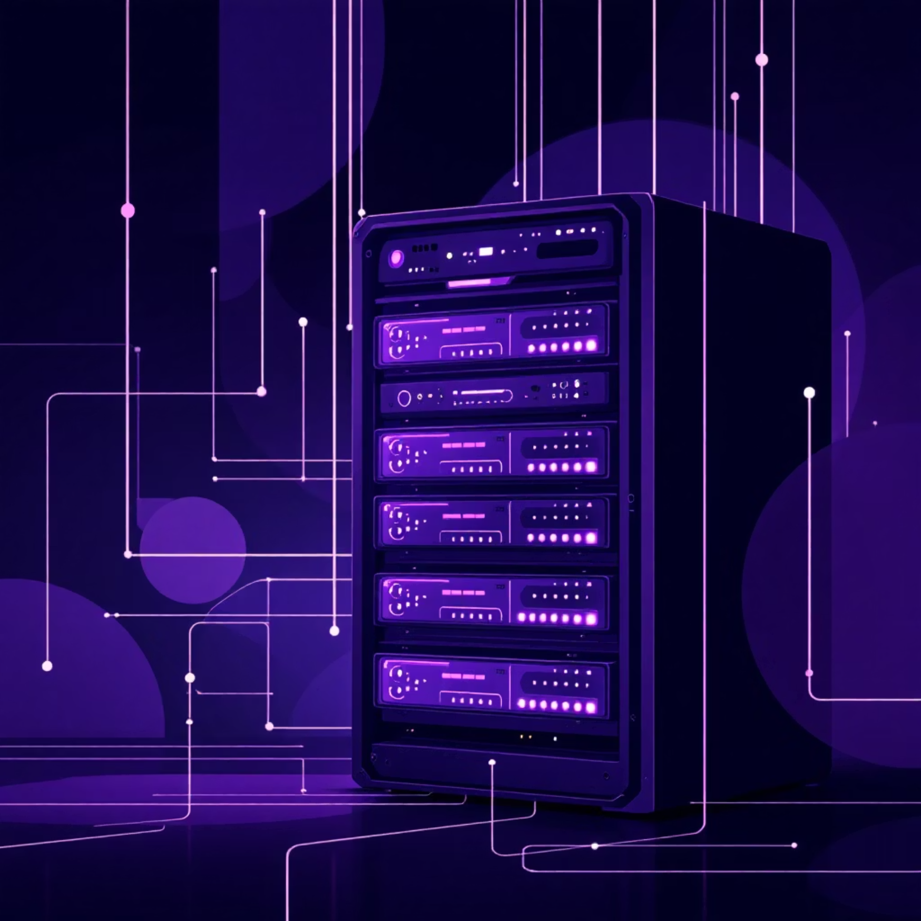
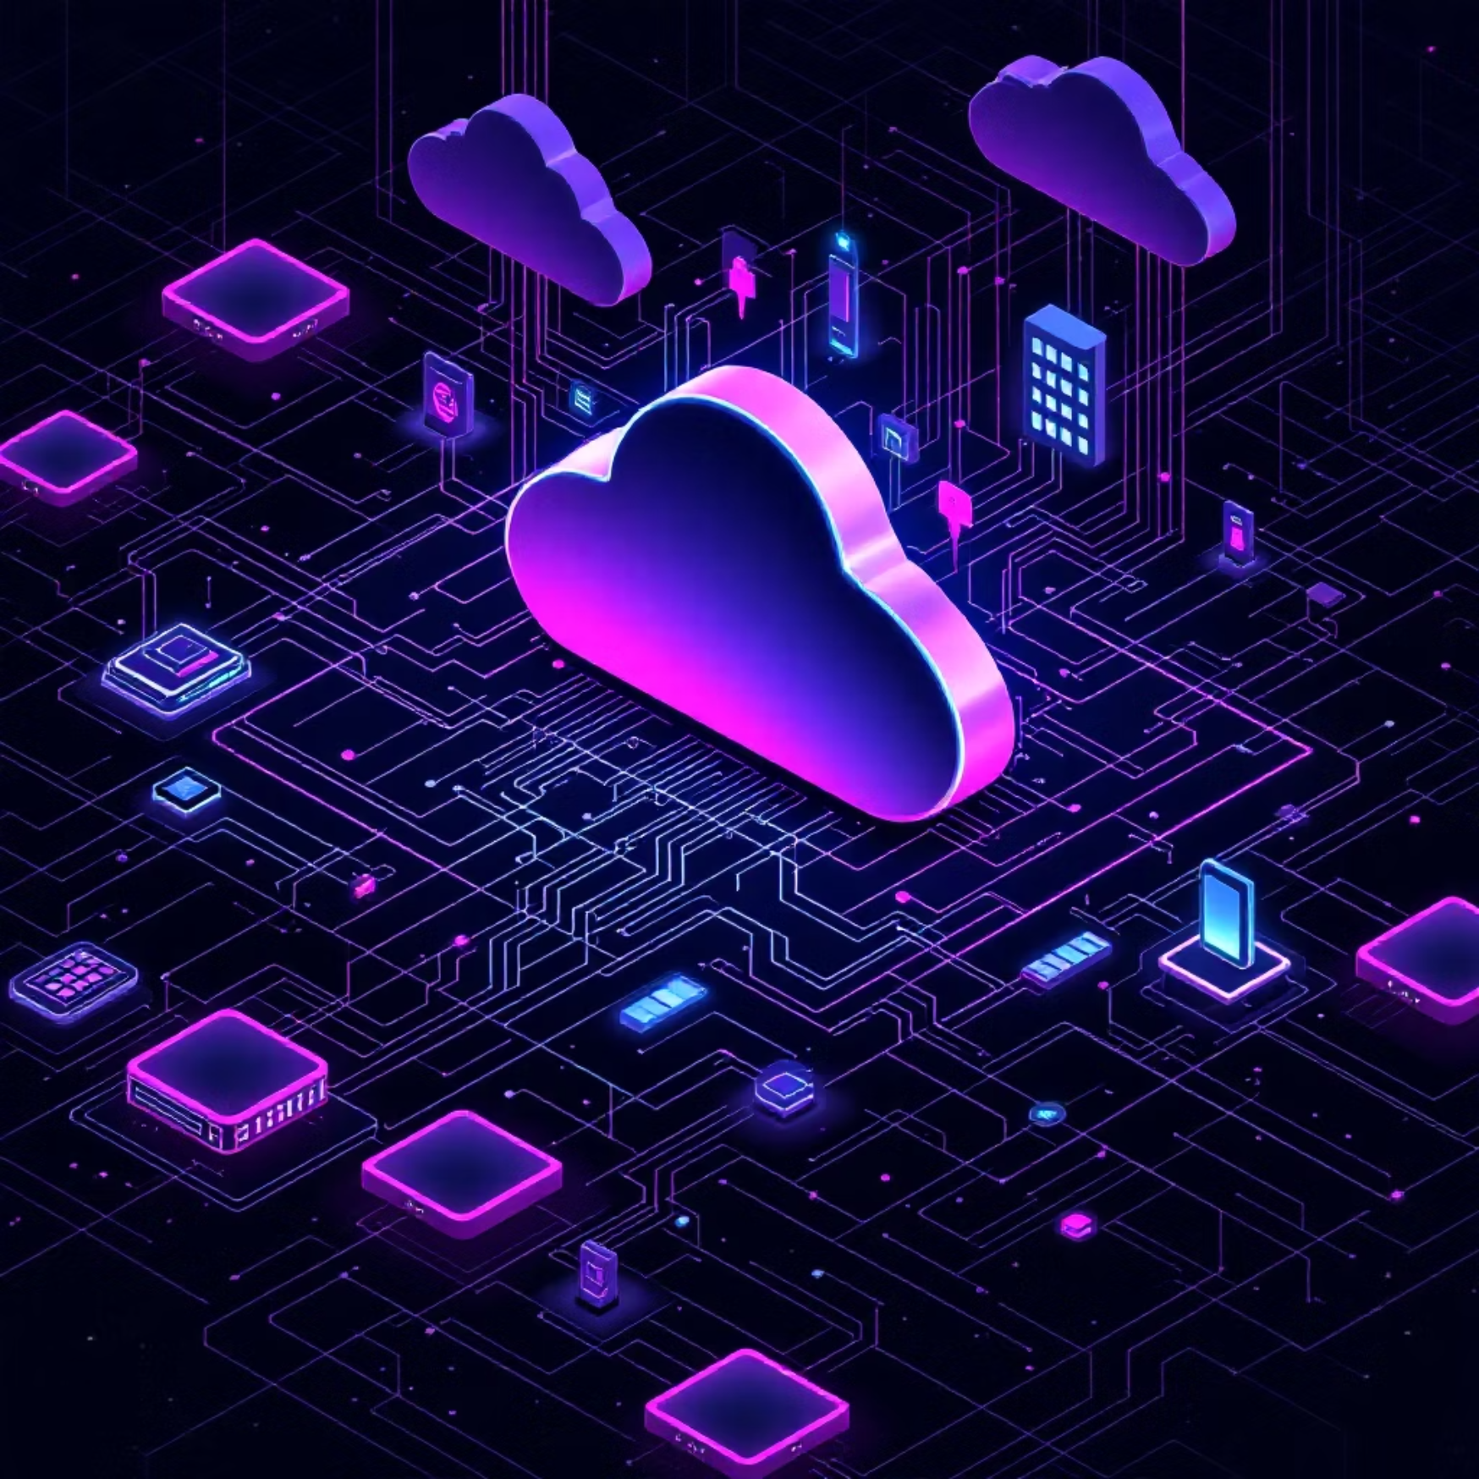
Decision Matrix: Serverless vs. VMs
Choose Serverless (Cloud Run) if:
Choose VMs/GKE if:
Your app is stateless (Web API, Microservice)
You need specific OS kernel control
Traffic is bursty or unpredictable
Workloads are long-running background processes (days/weeks)
You want to minimize ops overhead
You have legacy monolithic apps that can't be containerized easily
Request duration is under 60 minutes
Require persistent local storage
Cost optimization is a priority
Need specialized networking configurations

Slide 8
Service Equivalents Across Vendors
Capability
Google Cloud (GCP)
AWS
Azure
Serverless Containers
Cloud Run
AWS Fargate
Container Apps
Functions
Cloud Functions
AWS Lambda
Azure Functions
Registry
Artifact Registry
ECR
ACR
CI/CD
Cloud Build
CodePipeline
Azure DevOps
Identity & Access
Cloud IAM
AWS IAM
Azure AD
Secret Management
Secret Manager
Secrets Manager
Key Vault

Slide 9



What We Are Building Today
User
ADK Agent
Ollama + Gemma
External requests
FastAPI frontend
Publicly accessible
AI model backend
Privately secured
Platform
Security
Automation
Google Cloud Run
Serverless container deployment
Zero Trust
Service-to-service authentication
Cloud Build
CI/CD pipeline

Slide 10

Let's Get Started
https://github.com/mayurmadnani/workshop-gcp-intent-to-agents

